Slide 1
Vaccine Tracker
Team WFS:
Feng Peng 001086736
Jiaqi Sun 001535397
Jialin Wang 001561878

Slide 2
Agenda Style
01
Project Analysis
-Background
-Problem Statement
02
Flow Diagram
-Object Model
-Sequence Diagram
03
Work Request & Feature
04
User Case & UI Sample

Slide 3
Background
PANDEMIC
32,100
Need to be Resolved Immediately
100,300
78,000
80,120
89,000
During the whole year of 2020, scientists around the world are working on potential treatments and vaccines for the new coronavirus disease known as COVID-19. With confirmed COVID-19 cases in the United States surpassing 9.4 million and continuing to grow, scientists are pushing forward with efforts to develop vaccines to slow the pandemic and lessen the disease's damage. Over the upcoming months, we may see additional vaccines approved as COVID-19 targeted treatments, depending on the outcome of clinical trials.
40,100

Slide 4
Problem Statement
The Main Purpose:
Build a vaccine development and management system that will operate at the national, state and local organizations.
We are focusing on tracking the information of each vaccine and allowing volunteers to help the institution to test the vaccine.
A qualified vaccine must go through four testing stages before it is officially certified by the WHO.

Slide 5
Testing Stages
COVID-19
One vaccine can be approved to flow into the market must experience 4 testing stages:
Pre-clinical
Phase 1
Phase 2
Phase 3
Approved
Vaccine has not been used in human trials yet.
Vaccine can be distributed to the hospitals and used in small scale safety trials
Vaccine can be used in expanded scale trials around hundreds of people
Vaccine can be used in large-scale efficacy trials around thousands of people
Vaccine has been approved in general use

Slide 6
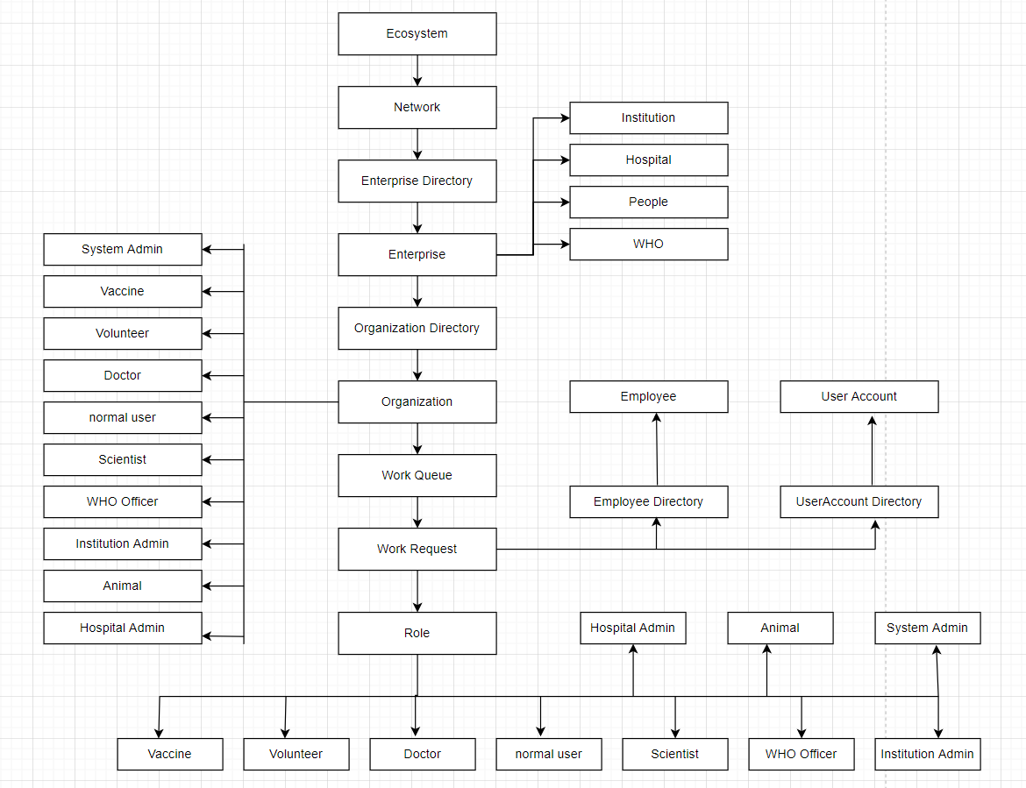
Object Model
Enterprise:
Institution
Hospital
People
WHO
Organization:
System Admin
Institution Admin
Scientist
Tester
Hospital Admin
Doctor
Volunteer
Normal User
WHO Officer
Volunteer Manager
Role:
Institution Admin
Scientist
Vaccine
Tester
Animal
Hospital Admin
Doctor
Volunteer
Normal User
WHO Officer
Volunteer manager
Notes:
https://drive.google.com/file/d/1Ej7H5WQ7e-UK7DuAFJsIcnckw8ul4Cwj/view?usp=sharing
把enterprise，role，organizatrion列出来

Slide 7
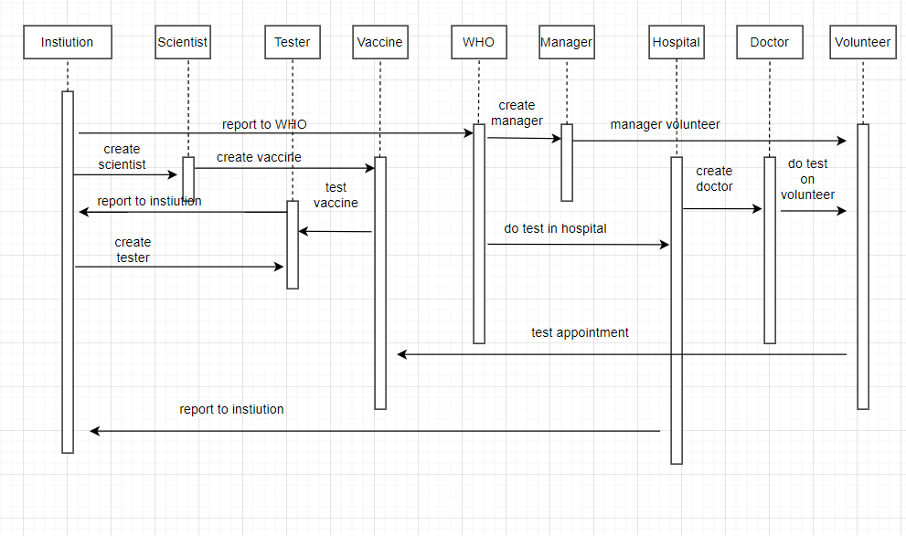
Sequence Diagram
User can login with the admin and create institution, hospital, people and WHO.
People can register as a volunteer to test the vaccine.
Institution can create scientist and tester.
Scientist can manage the vaccine.
Tester can do the preclinical tests.
WHO can agree/disagree the vaccine is pass.
Manager can manage the volunteer.
Hospital can report vaccine to institution.
Doctor can do the test for volunteer.
Please Use Hand Sanitizer

Slide 8
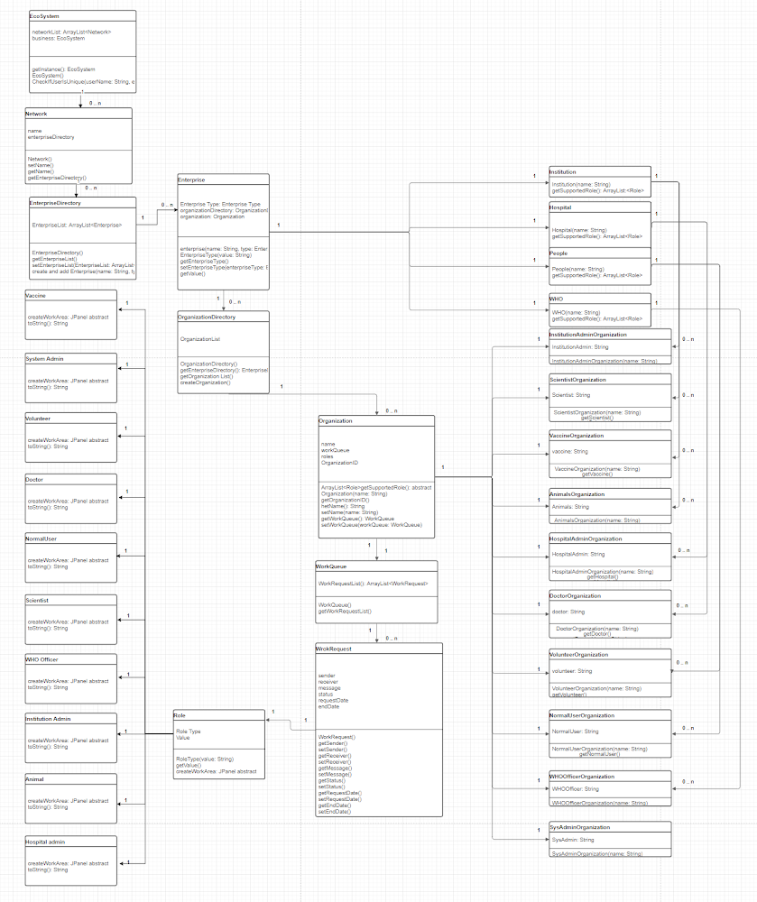
UML
https://app.diagrams.net/#G1Ej7H5WQ7e-UK7DuAFJsIcnckw8ul4Cwj

Slide 9
Work Request
WorkRequest represents the communication between different roles or organizations. In our system, we have four types of work requests, and all work requests store in the work queue. Those work requests are:
Report to WHO Request
Scientist Request Tester Request
Vaccine Shoot Request
Volunteer Application Request
Notes:
每一页题目不一样
每一个request的目的是什么 作用
一共几个work request
把每一个work request的名字写上去 介绍

Slide 10
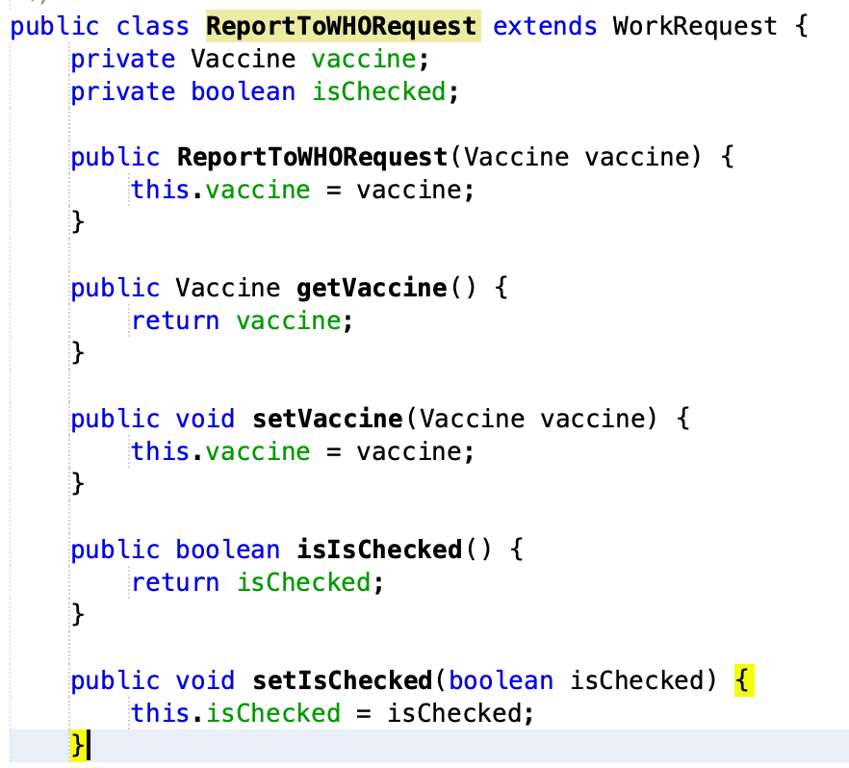
Report to WHO Request
This request represents the communication between the institution and WHO. After the institution finished the testing and wants to step into the next testing stage. It must need to be approved by WHO Office.
So, the sender of the request is the institution and the receiver is WHO Office. WHO Office will check the vaccine detail and determine whether the vaccine can go to the next stage. After checked, the isChecked attribute will be marked as true.
Notes:
有些vaccine会有状态，在什么时候会改变

Slide 11
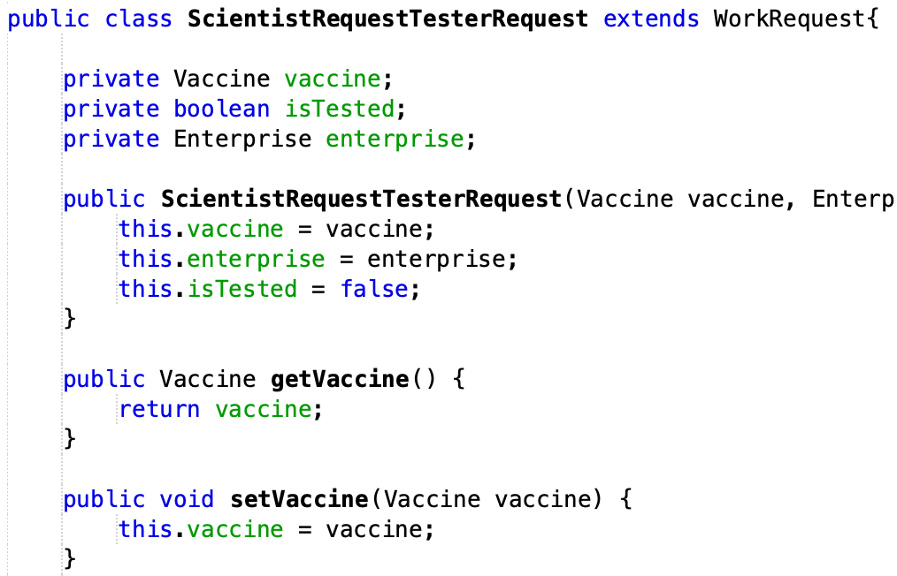
Scientist Request Tester Request
This request represents the data flow between Scientist and Tester. When the vaccine just produced, it’s too risky to experiment on people. So, we need to first test the vaccine on animals.
The main task of Tester is to help to experiment with the vaccine on animals. This request is within the enterprise itself, so we have an attribute to mark the enterprise.
After Tester tested the vaccine and reported it. The isTested will show the preclinical testing of the vaccine is complete.

Slide 12
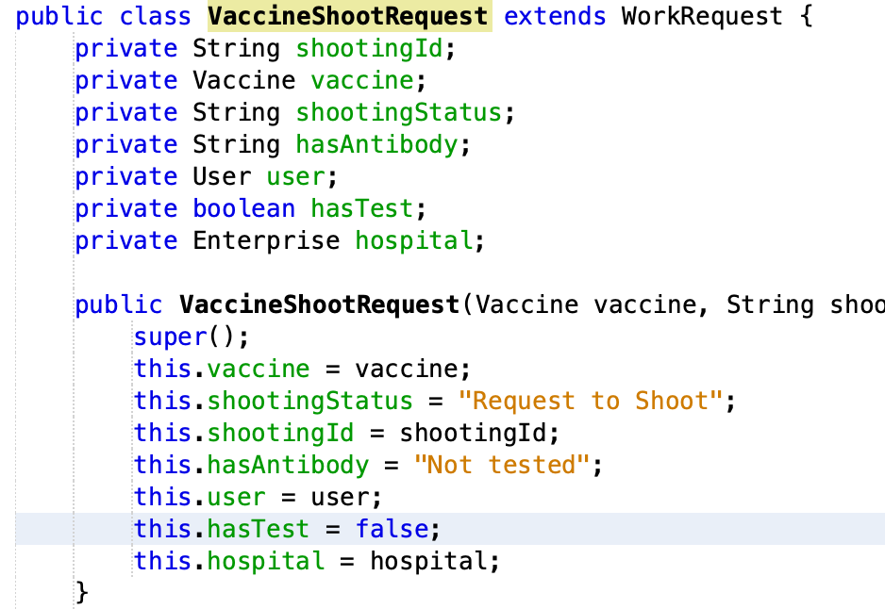
Vaccine Shoot Request
This request will be created after the volunteer making a testing appointment. So the sender of the request is a volunteer and the receiver is a hospital.
After the doctor of the hospital vaccinated the volunteer, the shooting status will become “Finished”. Afterward, the doctor can test whether the volunteer has an antibody. After testing completed, the hasTest attribute will become true.

Slide 13
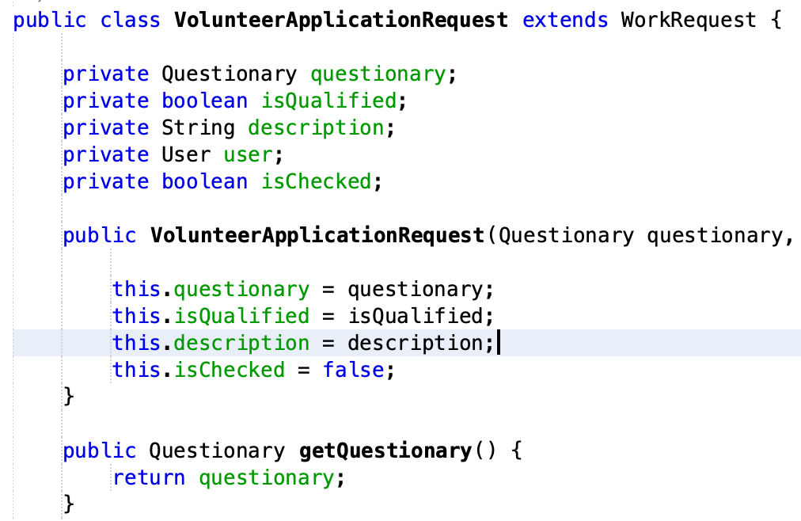
Volunteer Application Request
When a normal user wants to become a volunteer, he/she must submit a questionaire to determine whether he is qualified to become a volunteer, which is the main purpose of this request.
So the sender of the request is a volunteer and the receiver is the volunteer manager. isQualified attribute represents whether the normal user can become a volunteer. If it’s true, the role of the normal user will become a volunteer.

Slide 14
User Case
Institution
Scientist
Tester
Hospital
Create and update new scientist and tester
get vaccine report request list
When each vaccine finished one phase and ready to go to the next status, institution can report it to WHO
Add new vaccine information
request preclinical trial and choose hospital to request hospital test for a vaccine
select specific vaccine in the pre-clinical test request table and show the related information especially effective rate
input test result
report this vaccine to Admin
list all the vaccines distributed to this hospital
search vaccine’s name
create and update doctor’s information
report this vaccine to institution

Slide 15
User Case
Normal User
WHO
Manager
view all vaccines’ information in all institutions and all phases
if the normal user choose to be a volunteer, he/she can do a quick volunteer questionnaire and then wait for the approven
view phase test result
create and update volunteer manager’s information
view vaccine test request and choose if they want to confirm it
search by volunteer’s username or list all volunteers’ information and then choose if they want to confirm them to be a volunteer

Slide 16
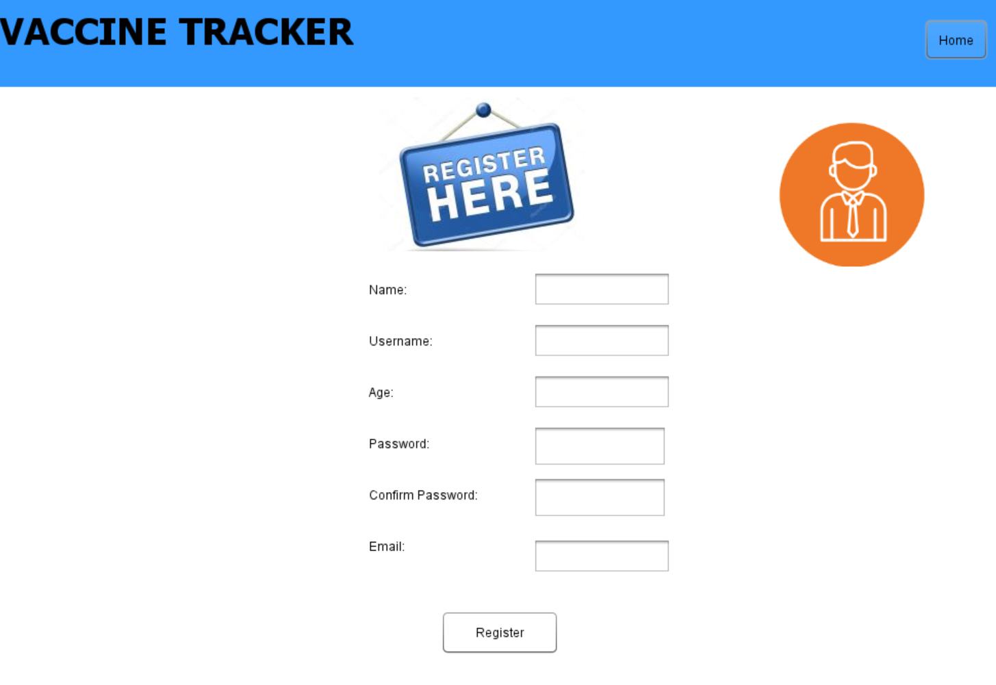
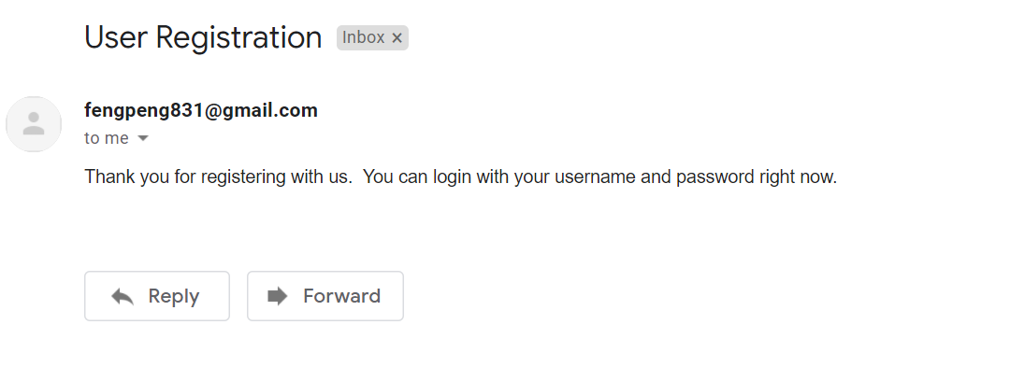
Feature
When one person just registered for a user account, he will receive an email and became a normal user.
When the normal user wants to become a volunteer, and he finished the volunteer questionnaire. After the volunteer manager checked his questionnaire and confirmed that he is qualified to become a volunteer. The person will receive an email and his role will change from normal user to volunteer.

Slide 17
THANK YOU
Insert the Subtitle of Your Presentation

